Slide 1

Advanced Pointers

Slide 2
Objectives
To learn and appreciate the following concepts
Operations on pointers
Pointers and Arrays
Pointers and Character Strings
Pointers and 2D
Array of Pointers

Slide 3
Session outcome
At the end of session one will be able to understand
Operations on pointers
Pointers and Arrays
Pointers and Character Strings
Pointers and 2D
Array of Pointers

Slide 4
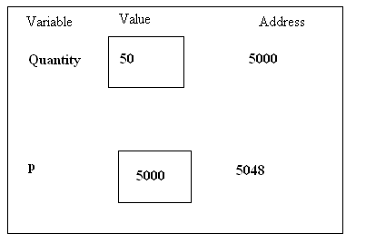
Pointers- A recap…
int Quantity; //defines variable Quantity of type int
int* p; //defines p as a pointer to int
p = &Quantity; //assigns address of variable Quantity to pointer p
Now…
Quantity = 50;//assigns 50 to Quantity
*p = 50; //assigns 50 to Quantity

Slide 5
Pointer expressions
Pointers can be used in most valid C expressions. However, some special rules apply.
You may need to surround some parts of a pointer expression with parentheses in order to ensure that the outcome is what you desire.
As any other variable, a pointer may be used on the right side of an assignment operator to assign its value to another pointer.
Notes:
Pointers can be used in most valid C++ expressions. However, some special rules apply.
You may need to surround some parts of a pointer expression with parentheses in order to ensure that the outcome is what you desire.
As with any variable, a pointer may be used on the right side of an assignment operator to assign its value to another pointer.

Slide 6
Pointer Expressions - Example
Eg: int a=10, b=20,c,d=10;
int *p1 = &a, *p2 = &b;
Expression | A | b | c
c = *p1**p2; OR *p1 * *p2 OR (*p1) * (*p2) | 10 | 20 | 200
c = c + *p1; | 10 | 20 | 210
c = 5 * - *p2 / *p1; OR ( 5 * (- (*p2)))/(*p1) //space between / and * is required | 10 | 20 | -10
*p2 =*p2 +10; | 10 | 30
Notes:
Like other variables, contents of pointer variables can be used in expressions. This slide gives example for expressions involving pointers. In these expressions, the value contained at the location pointed by pointer is used and NOT the value of pointer. Thus instead of the actual variable, we can use the pointer variable it is pointed by.
The space between / and * in 3rd expression is required ; otherwise it will be treated as a comment (/*)

Slide 7
Operations on Pointer Variables
Assignment – the value of one pointer variable can be assigned to another pointer variable of the same type
Relational operations - two pointer variables of the same type can be compared for equality, and so on
Some limited arithmetic operations
integer values can be added to and subtracted from a pointer variable
value of one pointer variable can be subtracted from another pointer variable
Shorthand Increment and Decrement Operators
Notes:
Some limited arithmetic operations
integer values can be added to and subtracted from a pointer variable
value of one pointer variable can be subtracted from another pointer variable
Increment/Decrement operations
Note: If p1 and p2 are both pointers to the same array, then p2-p1 gives the number of elements between p1 and p2.

Slide 8
Valid Pointer Operations - Example
int a = 10, b = 20, *p1, *p2, *p3, *p4;
p1 = &a; //assume address of a = 2004
p2 = &b; //assume address of b = 1008
Assume an integer occupies 4 bytes
Pointer Operations | Example expression | Result
Addition of integers from pointers | p3 = p1 + 2 | value of p3 = 2004 + 4*2 = 2012
Subtraction of integers from pointers | p4 = p2 – 2 | value of p4 = 1008-4*2 = 1000
Subtraction of one pointer from another | c = p3– p1 | Value of c = 2012– 2004= 2
Pointer Increment | p1++ | Value of p1 = 2008
Pointer Decrement | --p1 | Value of p1 = 2004
Notes:
As we've seen, you can add an integer to a pointer to get a new pointer, pointing somewhere beyond the original . For example, you might write
ip2 = ip1 + 3;
Applying a little algebra, you might wonder whether ip2 - ip1 = 3 and the answer is, yes. When you subtract two pointers, as long as they point to the same type, the result is the number of elements separating them.

Slide 9
Valid Pointer Operations - Example
if (p1<p2)
cout<<“p1 points to lower memory than p2”;
if (p1==p2)
cout<<“p1 and p2 points to same location”;
if (p1!=p2)
cout<<“p1 and p2 NOT pointing to same location”;
Notes:
Relational operations - two pointer variables of the same type can be compared for equality, and so on

Slide 10
Invalid Operations:
Pointers are not used in division and multiplication.
p1 / *p2;
p1*p2;
p1/3; are not allowed.
Two pointers can not be added.
p1 + p2 is illegal.
Notes:
The following are not allowed in C.
Add two pointers.
p1 = p1 + p2;
Multiply / divide a pointer in an expression.
p1 = p2 / 5;
p1 = p1 - p2 * 10;

Slide 11
Program to exchange two values using pointers
int main() {
int x, y, t, *a, *b;
a=&x; b=&y;
printf("Enter the values of a and b: \n");
scanf("%d %d", a, b); // equivalent to scanf(“%d %d”, &x, &y);
t=*a;
*a=*b;
*b=t;
printf("x = %d \n", x);
printf("y = %d", y);
return 0;
}
Enter the values of a and b:
10 5
x= 5
y = 10

Slide 12
Pointers and arrays
When an array is declared, the compiler allocates a Base Address (BA) and sufficient amount of storage to contain all the elements of the array in contiguous memory locations.
The base address is the location of the first element (index 0) of the array.
The compiler also defines the array name as a constant pointer to the first element.

Slide 13
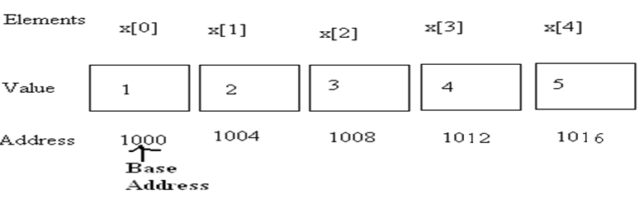
Pointers and arrays
An array x is declared as follows and assume the base address of x is 1000.
int x[5] ={ 1,2,3,4,5};
Array name x, is a constant pointer, pointing to the first element x[0] .
For example, if value of x is 1000 (Base Address), the location of x[0]. i.e. x is same as &x[0] equals 1000 (in the illustration below)
# Assume int takes 4 bytes
Notes:
Consider the following:
int my_array[] = {1,23,17,4,-5,100};
Here we have an array containing 6 integers. We refer to each of these integers by means of a subscript to my_array, i.e. using my_array[0] through my_array[5]. But, we could alternatively access them via a pointer as follows:
int *ptr; ptr = &my_array[0]; /* point our pointer at the first integer in our array */

Slide 14
Array accessing using Pointers
An integer pointer variable p, can be made to point to an array as follows:
int x[5] ={ 1,2,3,4,5};
int *p;
p = x; OR p = &x[0];
Following statement is Invalid:
p = &x ; //Invalid
Successive array elements can be accessed by writing:
printf(“%d”, *p);
p++;
or
printf(“%d”, *(p+i));
i++;
Notes:
The name x is defined as a constant pointer pointing to the first element, x[0] and therefore the value of x is 1000, the location where x[0] is stored.
i.e. is x =&x[0] →1000;
If we declare p as an integer pointer, then we can make the pointer p point to the array x by the following statement:
p=x; OR p=&x[0];
The following statement is invalid as value of x is 1000 (base address) and then we are applying address of operator on a constant:
p=&x;

Slide 15
Pointers and arrays
The relationship between p and x is shown below:
p= &x[0]; (=1000) BASE ADDRESS
p+1=>&x[1] (=1004)
p+2=>&x[2] (=1008)
p+3=>&x[3] (=1012)
p+4=>&x[4] (=1016)
Address of an element of x is given by:
Address of x[i] = base address + i * scale factor of (int)
Address of x[3]= 1000 +(3*4) = 1012
# Assume int takes 4 bytes

Slide 16
Array accessing using array name as a pointer - Example
// array accessed with constant pointer array name arr
int main()
{
int arr[5] = { 31, 54, 77, 52, 93 };
for(int j=0; j<5; j++) //for each element,
printf(“%d ”, *(arr+j)); //print value
return 0;
}
Notes:
Array name is a constant pointer. We can access the array elements by adding the index value to array name. Since array name is constant pointer, we cannot apply increment/decrement operator on it.(arr++).

Slide 17
Array accessing using Pointers - Example
// array accessed with explicit pointer ptr
int main() {
int arr[5] = { 31, 54, 77, 52, 93 };
int* ptr; //pointer to arr
ptr = arr; //points to arr
for(int j=0; j<5; j++) //for each element
printf("%d ", *ptr++);
return 0;
}
“ptr” is a pointer which can be used to access the elements.

Slide 18

Sum of all elements stored in an array
int main() {
int *p, sum=0, i=0;
int x[5] ={5, 9, 6,3,7};
p=x;
while(i<5) {
sum+=*p;
i++;
p++;
}
printf("sum of elements = %d“, sum);
return 0;
}

Slide 19
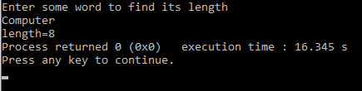
Pointers & Character strings
//length of the string
int main() {
char name[15];
char *cptr=name;
printf("Enter some word to find its length: \n“);
scanf(“%s”, name);
while(*cptr!= '\0')
cptr++;
printf("length= %d“, cptr-name);
return 0;
}

Slide 20
Pointers & Character strings
The statements
char name[10];
char *cptr =name;
declares cptr as a pointer to a character array and
assigns address of the first character of name as the
initial value.
The statement while(*cptr!=‘\0’)
is true until the end of the string is reached.
When the while loop is terminated, the pointer cptr holds the address of the null character [‘\0’].
The statement length = cptr – name; gives the length of the string name.

Slide 21
Pointers & Character strings
A constant character string always represents a pointer to that string.
The following statements are valid.
char *name;
name =“Delhi”;
These statements will declare name as a pointer to character array and assign to name the constant character string “Delhi”.

Slide 22
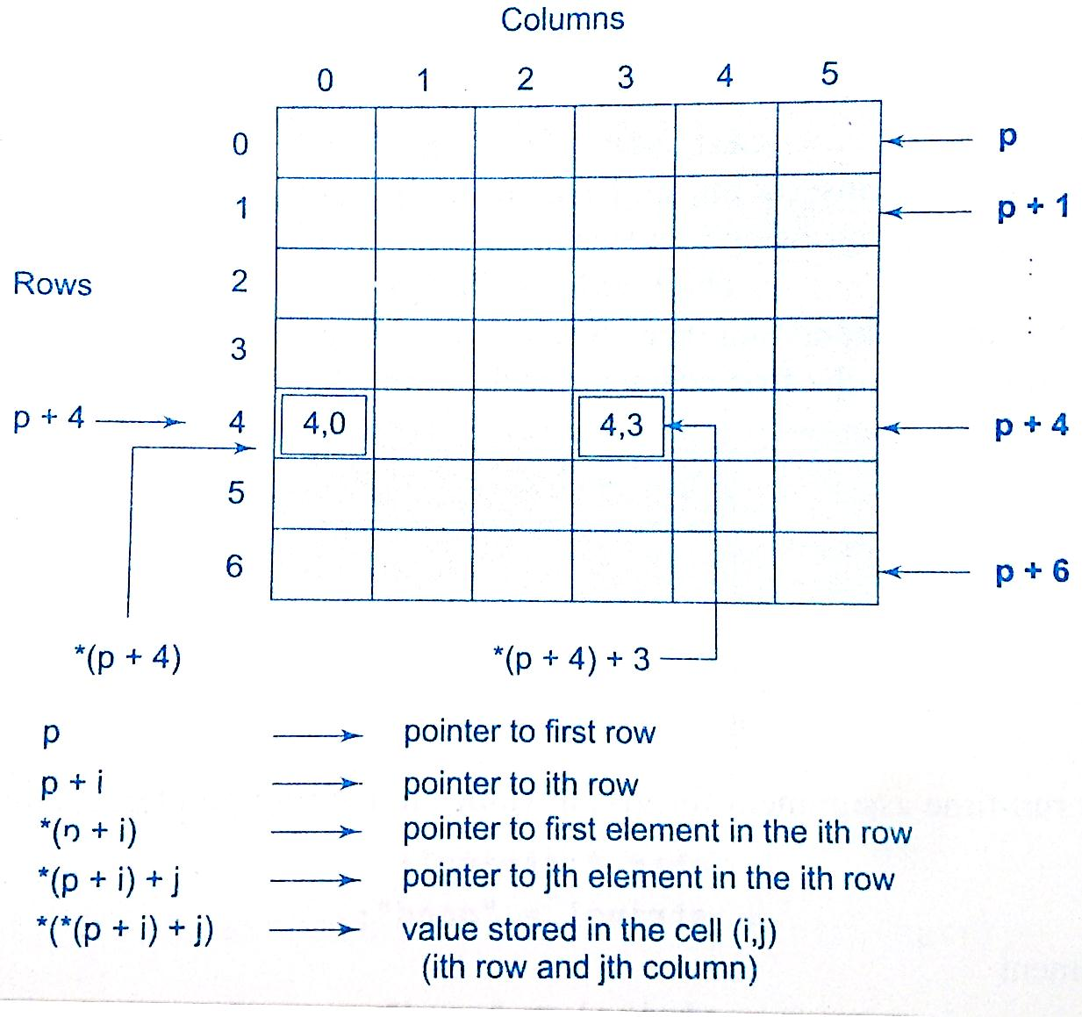
Pointers and 2D arrays
int a[ ][2]={ {12, 22},
{33, 44} };
int (*p)[2];
p=a; // initialization
So, an element in 2d represented as
*(*(a+i)+j)
or
*(*(p+i)+j)
*(*(p+4)+3)

Slide 23
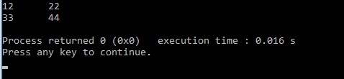
Pointers and 2D arrays
// 2D array accessed with pointer
int main() {
int i, j, (*p)[2], a[][2] = {{12, 22}, {33, 44} };
p=a;
for(i=0;i<2;i++) {
for(j=0;j<2;j++)
printf(“%d \t“, *(*(p+i)+j));
printf("\n“);
}
return 0;
}

Slide 24
Array of pointers - concept
We can use pointers to handle a table of strings.
char sports[5][15];
sports is a table containing 5 sport names, each with a maximum length of 15 characters (including ‘\0’)
Total storage requirement for sports is 75 bytes.
But rarely all the individual strings will be equal in lengths.
We can use a pointer to a string of varying length as
char *sports[5] = { “golf”, “hockey”, “football”, “cricket”, “shooting” };

Slide 25
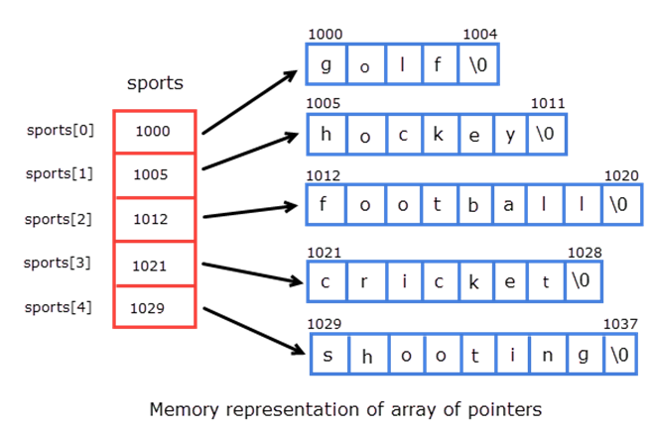
Array of pointers
So, char *sports[5] = { “golf”,
“hockey”,
“football”,
“cricket”,
“shooting”};
Declares sports to be an array of 5 pointers to characters, each pointer pointing to a particular sport.
sports[0] → golf
sports [1]→ hockey
sports [2]→ football
sports [3]→ cricket
sports [4]→ shooting
This declaration allocates 33 bytes.

Slide 26
Array of pointers
The following statement would print out all the 5 names.
for(i=0; i<=5; i++)
printf(“%s”,sports[i]);
or
printf(“%s”, *(sports + i));
To access the j^{th} character in the i^{th} name, we may write as
*(sports[i] + j)
The character array with rows of varying lengths are called ragged arrays and are better handled by pointers.

Slide 27
Benefits (use) of pointers
Pointers provide direct access to memory.
Pointers provide a way to return more than one value to the functions.
Reduces the storage space and complexity of the program.
Reduces the execution time of the program.
Provides an alternate way to access array elements
Pointers can be used to pass information back and forth between the calling function and called function.

Slide 28
Drawbacks of pointers
Uninitialized pointers might cause Segmentation fault.
Dynamically allocated block needs to be freed explicitly. Otherwise, it would lead to Memory leak.
Pointers are slower than normal variables.
If pointers are updated with incorrect values, it might lead to Memory corruption.
Notes:
Segmentation fault: In computing, a segmentation fault or access violation is a fault, or failure condition, raised by hardware with memory protection, notifying an operating system the software has attempted to access a restricted area of memory.
Memory leak: In computer science, a memory leak is a type of resource leak that occurs when a computer program incorrectly manages memory allocations in such a way that memory which is no longer needed is not released. A memory leak may also happen when an object is stored in memory but cannot be accessed by the running code.
Memory corruption: Memory corruption occurs in a computer program when the contents of a memory location are modified due to programmatic behavior that exceeds the intention of the original programmer or program/language constructs; this is termed violating memory safety. The most likely cause of memory corruption is programming error

Slide 29
Summary
Pointers -recap
Basic operations on pointers
Pointers and Arrays
Pointers and Character Strings
Pointers and 2D
Array of Pointers

